Slide 1

Introduction
to
Competitive
Programming

Slide 2


---------
My Portfolio:

Slide 3
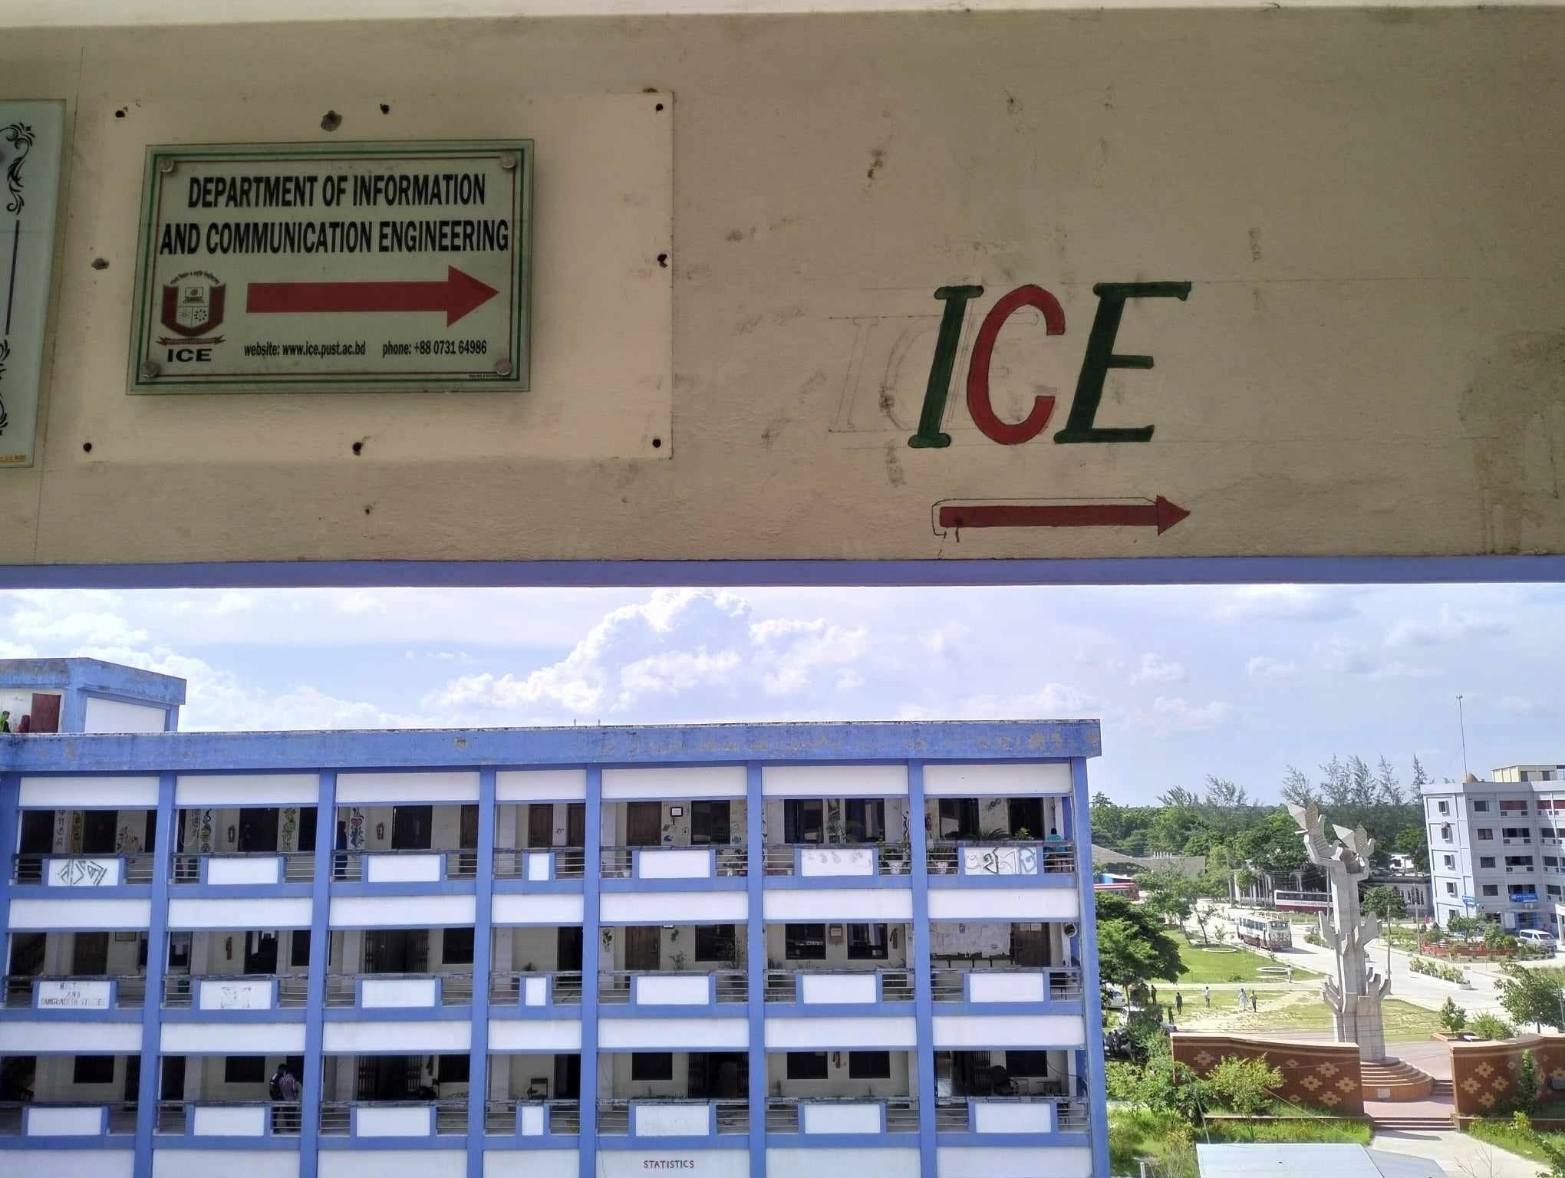
Welcome to

Slide 4
Ask Question?

Slide 5
What is Competitive Programming?

Slide 6
What A person Should know to do competitive Programming?

Slide 7
Programming Language
C
C++(Best for Competitive Programming)
C#
Python
Java
Javascript
PHP

Slide 8
From a Language:
1.Variable+Operators
2.Input+Output
3.If-else
4.Loop
5.Array
6.String
7.Break+Continue
8.Function+(Recursion)
Data Structure & Algorithm

Slide 9

Standard template library
(STL)
1.Vector
2.Pair
3.Lists
4.Deque
5.Stack
6.Queue
7.Priority Queue
8.Set(MultiSet, Unordered Set)
9.Map (MultiMap, Unordered Map)
10.Algorithms(Sort, max, min, Permutation etc.)

Slide 10
Why is it so Important?
Where should we do Competitive Programming?

Slide 11





Websites for Competitive Programming:

Slide 12

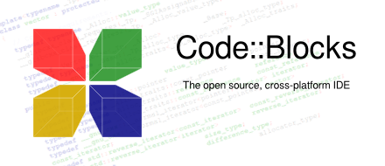
Where Should We Write the code?
Visual Studio Code(VS Code)

Slide 13
Contest?
Yes.As more as you can……

Slide 14

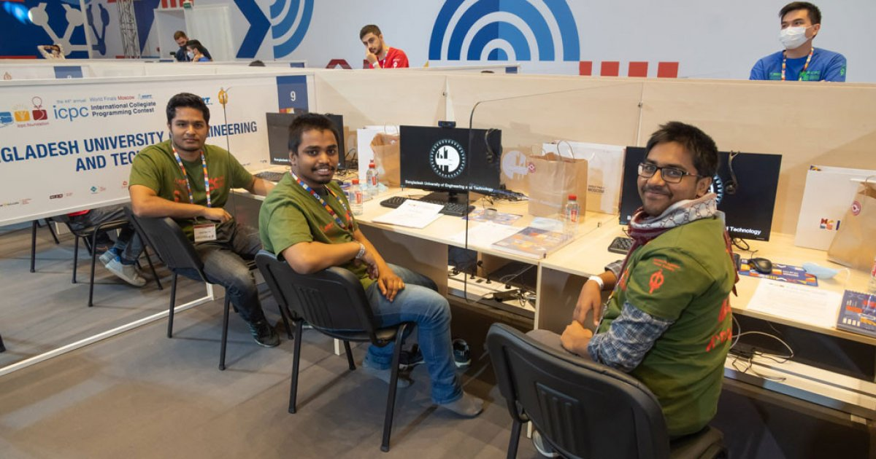

Slide 15


Slide 16
Thanks You!
Mail:monjurmorshedosama75@gmail.com
Phone:+880 1997-007988

